Slide 1
Ch 5. Data Structures Pt. 1
Arrays
3. The main(String[] args) and Beyond Pg. 55-56

Slide 2
Passing Strings as arguments
public static void main(String[] args)
PS C:\Users\...\desktop> javac ArgsProcessor.java
PS C:\Users\...\desktop> java ArgsProcessor 10 5
PS C:\Users\...\desktop> javac ArgsProcessor.java
PS C:\Users\...\desktop> java ArgsProcessor Hello World “My Program”

Slide 3
Create a program called
ArgsProcessor.java
- Prompt values as arguments and process them into tokens.
- Perform the addition of the prompted input values.
-Interpret the following block of code.

Slide 4
Adding Values: Detect the potential syntax errors
public class Array3{
public static void main(String[] a){
System.out.println("Total size: " + a);
if(a.length < 0){
System.out.println("Nothing to process");
}
else{
int x = a[0];
int y = a[1];
int z = x + y;
System.out.println("The sum is: " + z);
}
}
}

Slide 5
PS C:\Users\...\desktop> javac Array3.java
Array3.java:8: error: incompatible types: String cannot be converted to int
int x = args[0];
^
Array3.java:9: error: incompatible types: String cannot be converted to int
int y = args[1];
^
2 errors

Slide 6
The .length
if(args.length < 0){
//Nothing to process
}
else{
//Process the arguments
}
=

Slide 7
How to process tokens: The Split() Method
String message = "Computer Science";
String[] array = message.split(" ");
System.out.println(array[0]);
System.out.println(array.length);
System.out.println(message.split(" ")[0]);

Slide 8
“Computer”
“Science”
0
1

Slide 9
Output
PS C:\Users\...\desktop> javac ArgsProcessor.java
PS C:\Users\...\desktop> java ArgsProcessor
Nothing to process
PS C:\Users\...\desktop> java ArgsProcessor -2 -7 8 2 24 6
Addition: 31
PS C:\Users\...\desktop> java ArgsProcessor "-2" "-7" "8" "2" "24" "6"
Addition: 31
PS C:\Users\...\desktop> java ArgsProcessor -2 "-7 8 2 24 6"
Addition: 31
PS C:\Users\...\desktop> java ArgsProcessor "-2 -7 8 2 24" 6
Addition: 31
PS C:\Users\...\desktop> java ArgsProcessor "-2 -7" "8 2" "24 6"
Addition: 31

Slide 10
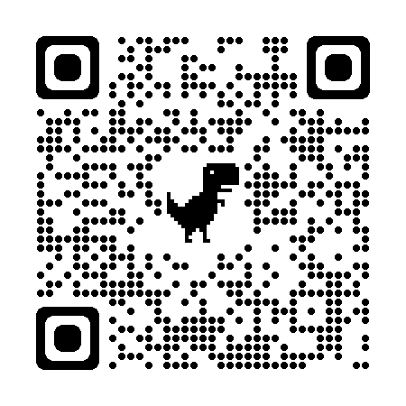
Resources

